Slide 1
DIGITAL PORTFOLIO

Slide 2
PROJECT TITLE
STUDENT NAME: KOWSIK M
REGISTER NUMBER AND NMID:2422K1582 AND asbru4q2422k1582
DEPARTMENT: COMPUTER SCIENCE
COLLEGE:KSG COLLEGE OF ARTS AND SCIENCE
UNIVERSITY: BHARATHIAR UNIVERSITY

Slide 3
AGENDA
1.problem statement
2.project overview
3.end user
4.tools and technology
5.portfolio design and layout
6.features and functionality
7.results and screenshot
8.conclusion

Slide 4
PROBLEM STATEMENT
Project Statement
Objective :Defines what the project aims to achieve.
Scope: Outlines the boundaries and deliverables of the project. Problem Addressed: Describes the challenge or opportunity the project tackles. Expected Outcomes:: Highlights the anticipated results or benefits.

Slide 5
PROJECT OVERVIEW
Project Overview
Purpose:Establish a sustainable pineapple product manufacturing unit. Objectives: Produce high-quality pineapple juice, canned pineapple, etc., meeting market demand. Scope: Includes production, quality control, marketing. Deliverables: Pineapple products for domestic/international markets.

Slide 6
WHO ARE THE END USERS
End Users Demographics : Age, location, income level, etc. Consumers :People buying pineapple juice or canned pineapple for consumption. Retailers: Stores selling pineapple products to consumers.
Food Service Industry: Hotels, restaurants using pineapple products. Export Markets: Businesses importing pineapple products.

Slide 7
TOOLS AND TECHNOLOGIES
1. *Project Management Tools:Software like Asana, Trello, MS Project for planning and tracking. 2. *Design and Development Tools Figma, Adobe Creative Suite for design; coding languages like Python, JavaScript for development. 3. *Collaboration Tools Slack, Microsoft Teams for team communication. 4. *Quality Control Techniques: Testing, inspection methods to ensure product quality.

Slide 8
PORTFOLIO DESIGN AND LAYOUTS
1. Visual Hierarchy:Guides viewer attention to key pieces or highlights. 2. Navigation:Easy-to-use menus or sections for browsing. 3. Content Presentation: Balance of text, images, projects showcasing skills. 4. Brand Identity Reflects creator’s personal or professional brand.

Slide 9
FEATURES AND FUNCTIONALITY
Features and Functionality
1. *User Experience (UX)*: How users interact with and perceive a product/system. 2. *Core Features*: Primary attributes or services offered (e.g., search, login). 3. *Usability*: Ease of use and intuitiveness for users. 4. *Performance*: Speed, reliability, scalability aspects 5.Website*: Features like contact forms, galleries; functionality like responsive design. -6.*Mobile App*: Features like push notifications; functionality like smooth navigation.

Slide 10


RESULT AND SCREENSHOTS

Slide 11
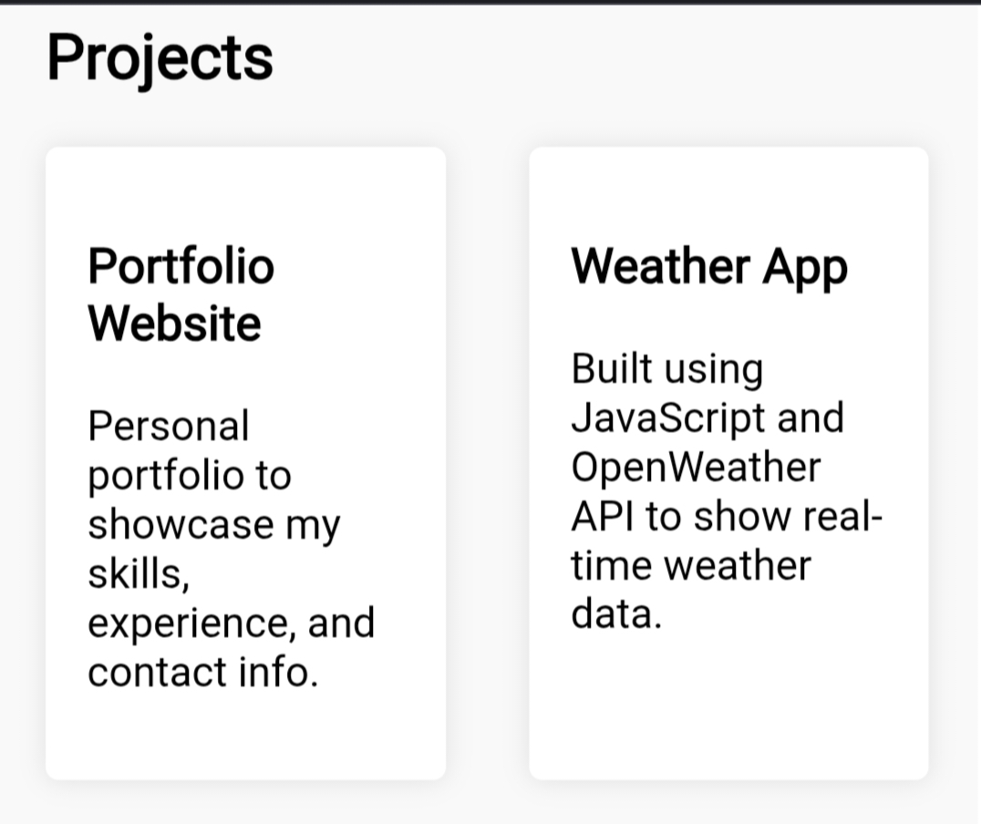
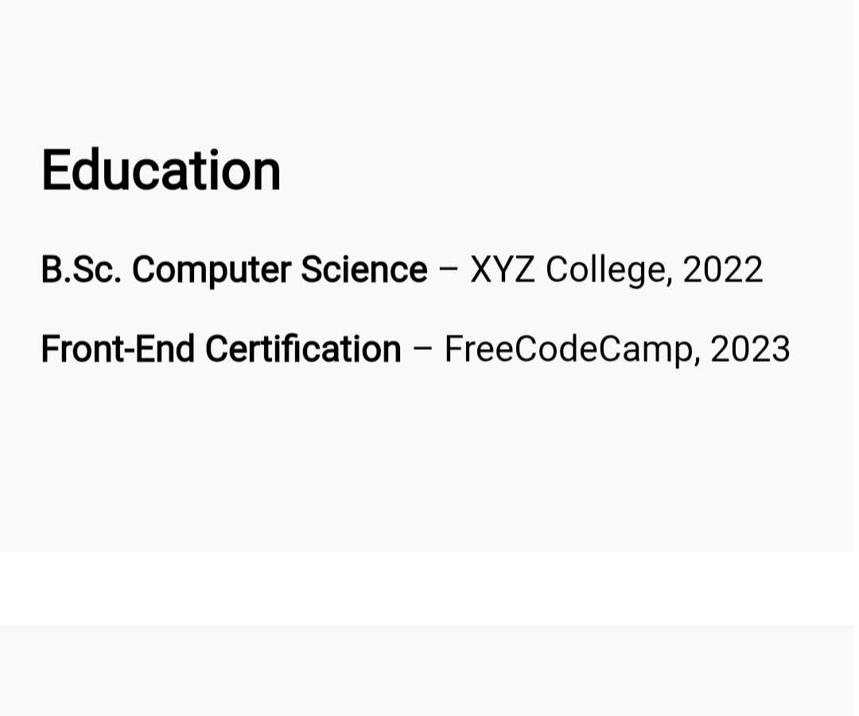
SCREENSHOT

Slide 12
CONCLUSION
- We discussed *portfolio design and layout*, focusing on visual hierarchy and showcasing work. - *Features and functionality* were touched upon, highlighting user experience and usability. - Conversations included *project overview*, *end users*, *tools and techniques*. - Apply these concepts to a particular project

